Slide 1
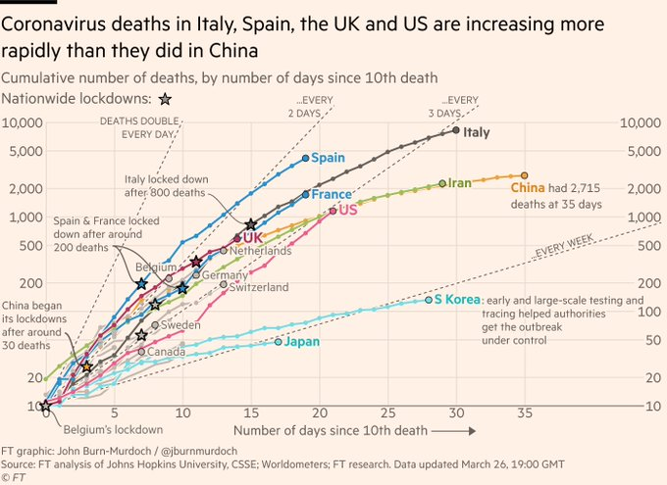
Case Study
Financial Times Coronavirus Tracker

Slide 2

A visualization by John Burn-Murdoch
British data visualization journalist,
Worked in Guardian
Now on Financial Times
Twitter: https://twitter.com/jburnmurdoch

Slide 3
Step 1: The project – Audience and medium
Subject:
Very sensitive
Full attention (Feb-March 2020)
Audience:
Financial Times readers…but… decided to open outside the paywall
Non-specialists
People not used to charts
Different geographies
Medium:
Digital version on desktop, tablet and mobile
Social media
Notes:
Mobiles were (and are) the main traffic source

Slide 4
Step 2: The data
Data not fully reliable
Multiple origins, multiple countries
Timeframe of collected data
Wait time
Different time zones
What a “death” means:
Only in hospital
Only if tested Coronavirus
Only if reported
Too much data
Noisy data
Double check
Talk with specialists, with local people
Constant updates

Slide 5
Step 3: Charts and encodings
Time is critical
24h update
Selection:
Deaths
Which countries: story need, audience need, representation need
Context:
Reference lines: speaking the language of audience

Slide 6
Step 3: The Financial Times Coronavirus Tracker

Slide 7
Design decisions
Reference lines
Repeated axes
Categorical colour scale, but semantic grouping
+ clarity
+ standards
Lots of labels and comments
=> Static version prioritized
Logarithmic scale
Notes:
What Will the interactive versión add?

Slide 8
Step 4: Implementation decisions
Multiple versions through an automatic process; just final fne-tuning
The chart was published soon, it was refined over time
Notes:
What Will the interactive versión add?

Slide 9
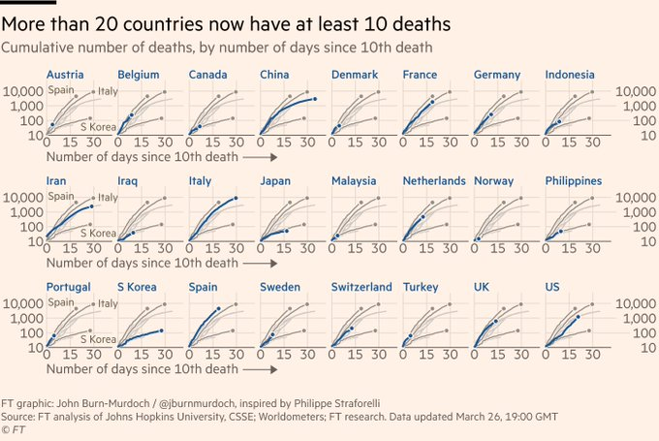
Plus additional charts: small multiples to the rescue
Notes:
Just to make different audiences happy

Slide 10
References
S1E3 – JOHN BURN-MURDOCH – The Financial Times’ Coronavirus Tracker, within Explore Explain, by Andy Kirk https://www.youtube.com/watch?v=rplwvdOmKKc

